Slide 1



Data Analytics final project presentation
View in Power BI
Last data refresh:
4/17/2022 2:29:59 PM UTC
Downloaded at:
4/17/2022 2:39:34 PM UTC

Slide 2
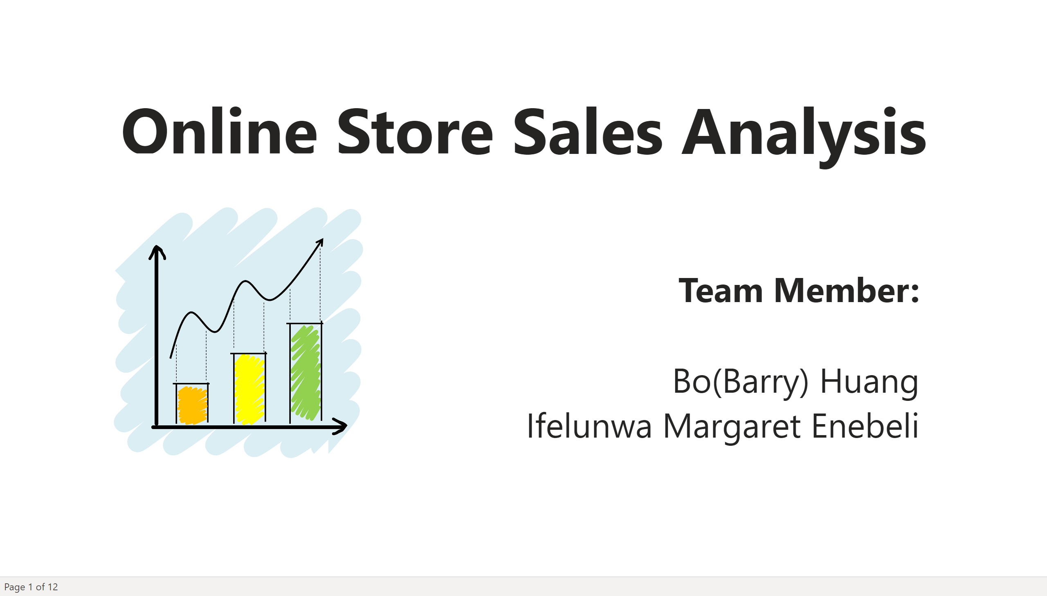
Cover
Notes:
textbox
No alt text provided
textbox
No alt text provided
image
No alt text provided

Slide 3
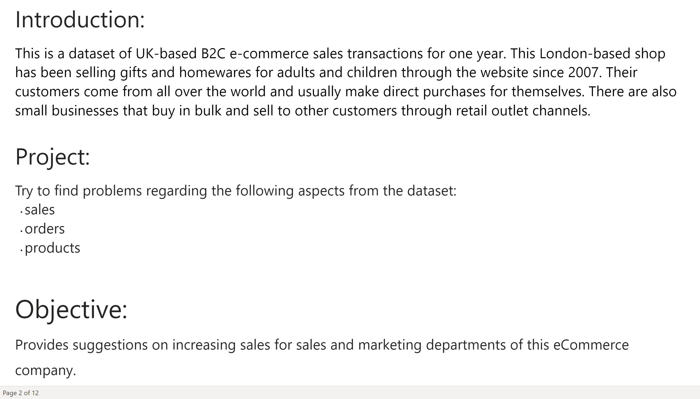
Introduction
Notes:
textbox
No alt text provided
textbox
No alt text provided
textbox
No alt text provided

Slide 4
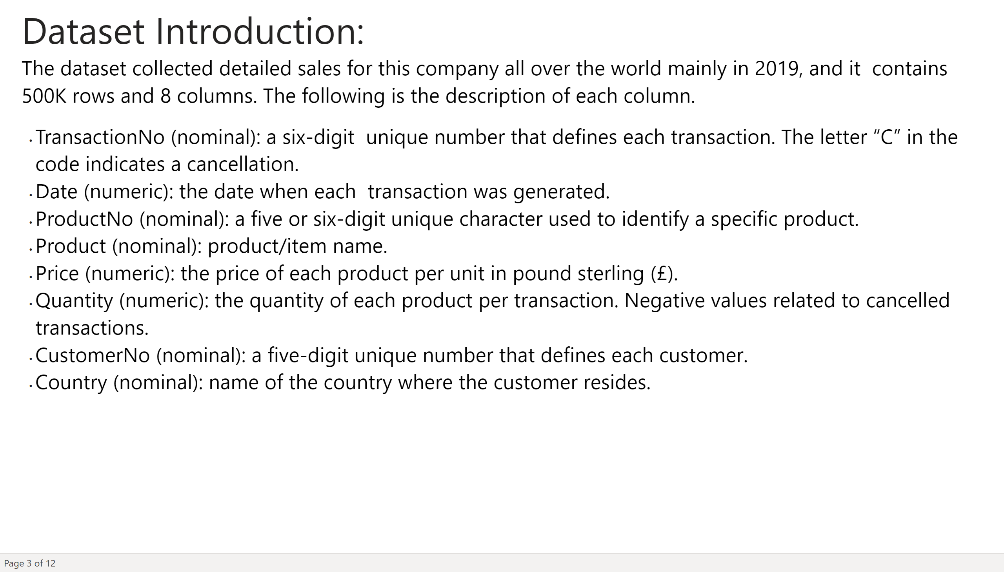
dataset introduction
Notes:
textbox
No alt text provided

Slide 5
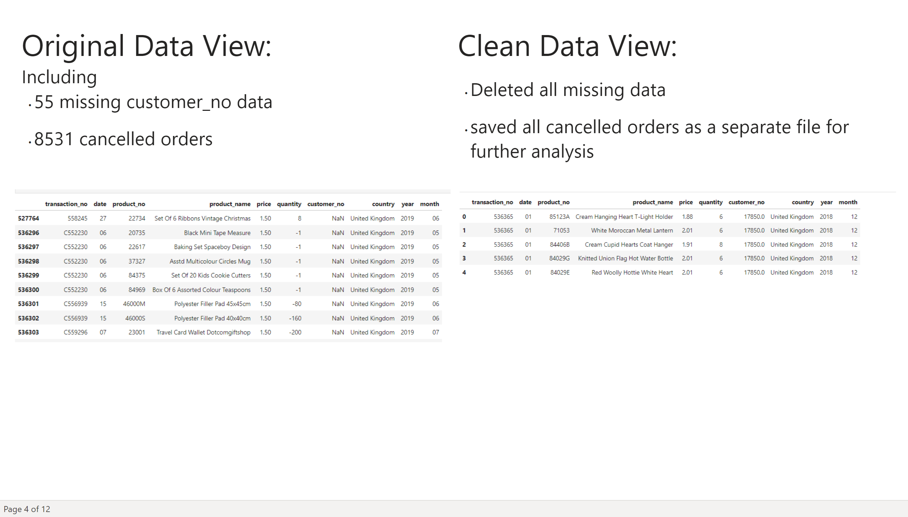
data clean
Notes:
textbox
No alt text provided
image
No alt text provided
textbox
No alt text provided
image
No alt text provided

Slide 6
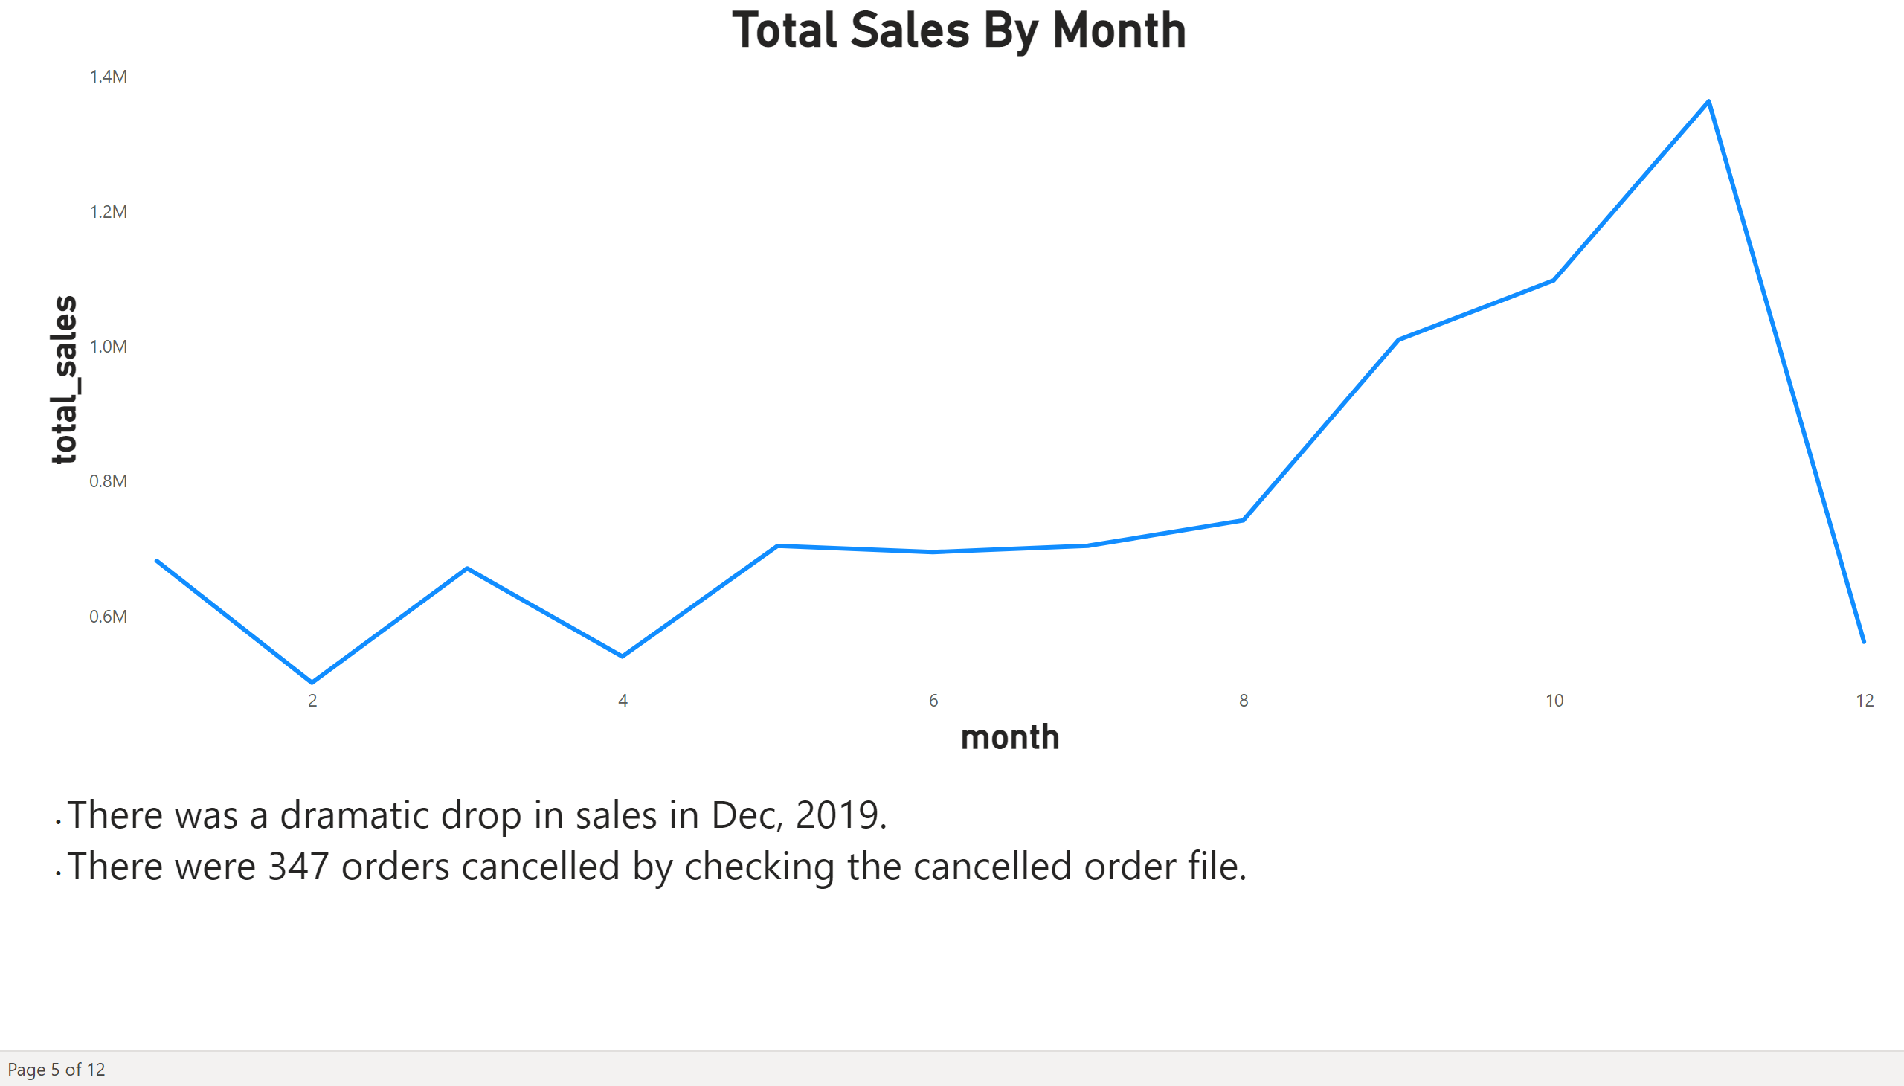
Total Sales by Month
Notes:
Total Sales By Month
No alt text provided
textbox
No alt text provided

Slide 7
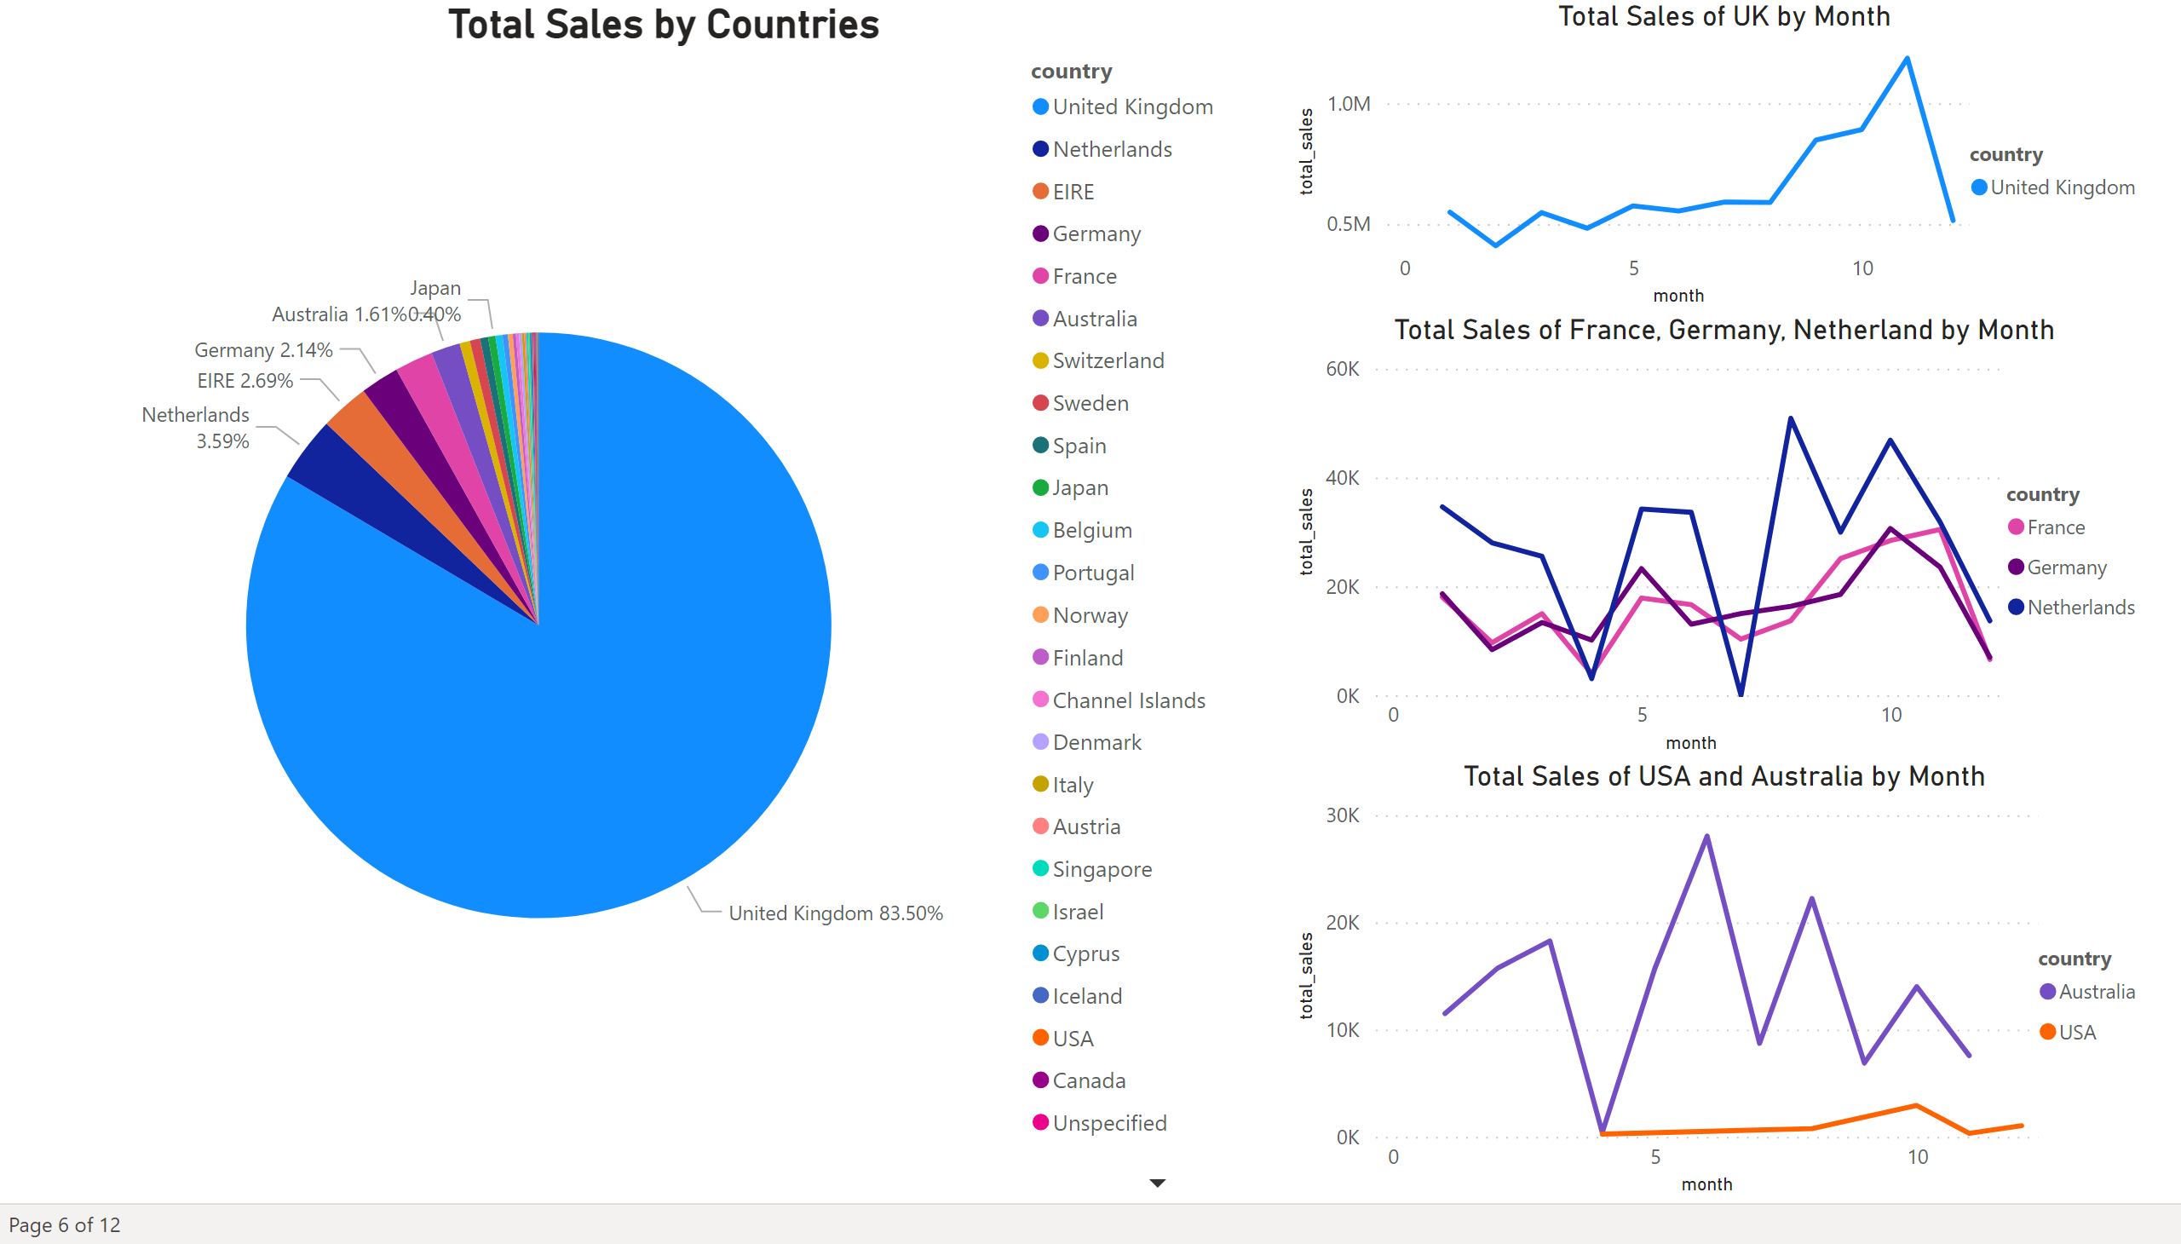
Total sales by country
Notes:
Total Sales by Countries
No alt text provided
Total Sales of France, Germany, Netherland by Month
No alt text provided
Total Sales of UK by Month
No alt text provided
Total Sales of USA and Australia by Month
No alt text provided

Slide 8
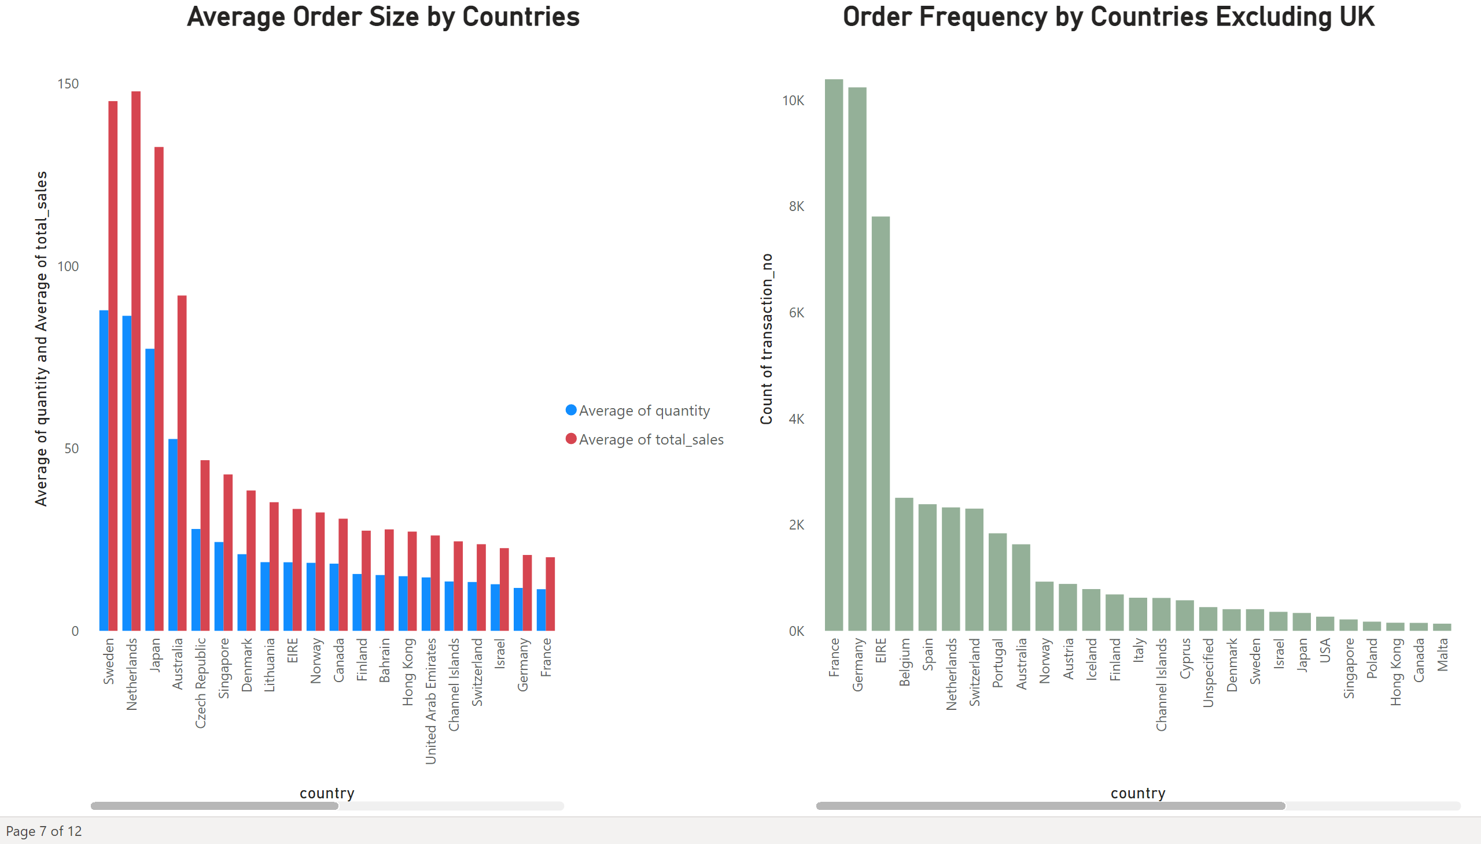
Average Order Size by Countries
Notes:
Average Order Size by Countries
No alt text provided
Order Frequency by Countries Excluding UK
No alt text provided

Slide 9
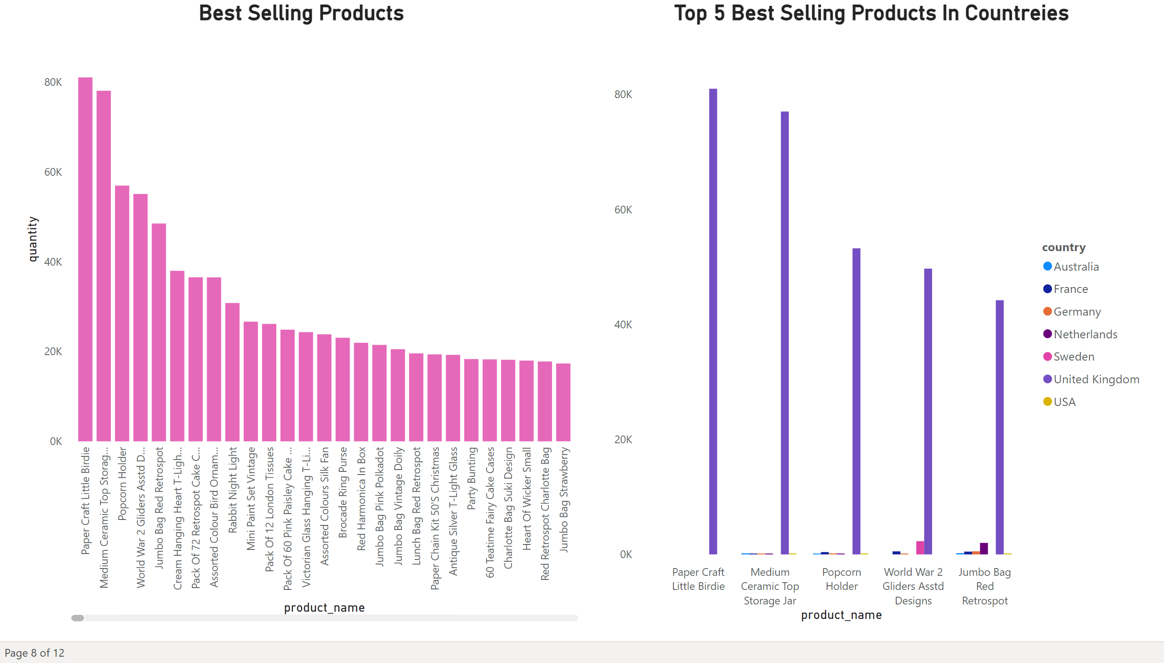
Best Selling Products
Notes:
Best Selling Products
No alt text provided
Top 5 Best Selling Products In Countreies
No alt text provided

Slide 10
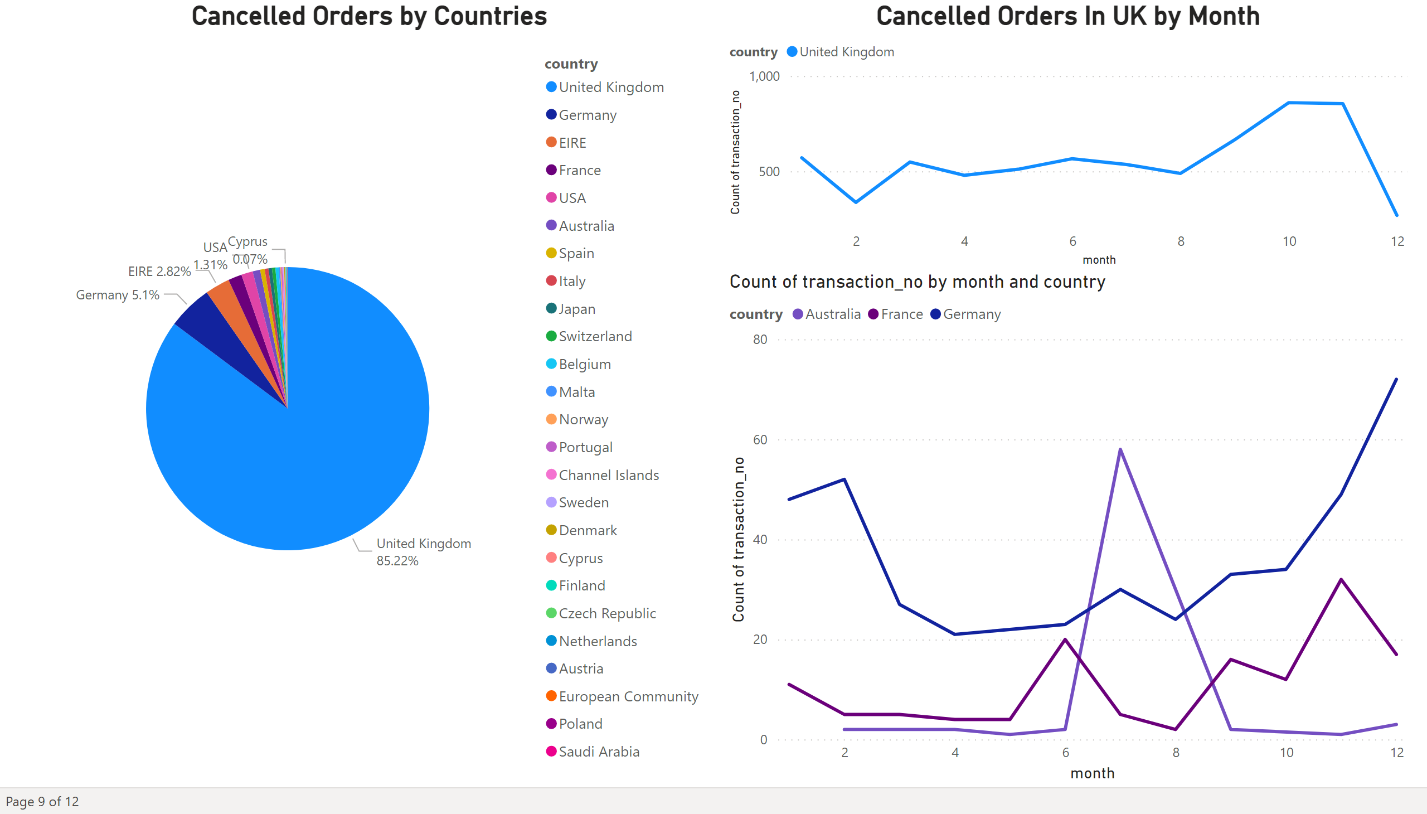
Cancelled Orders
Notes:
Cancelled Orders by Countries
No alt text provided
Cancelled Orders In UK by Month
No alt text provided
lineChart
No alt text provided

Slide 11
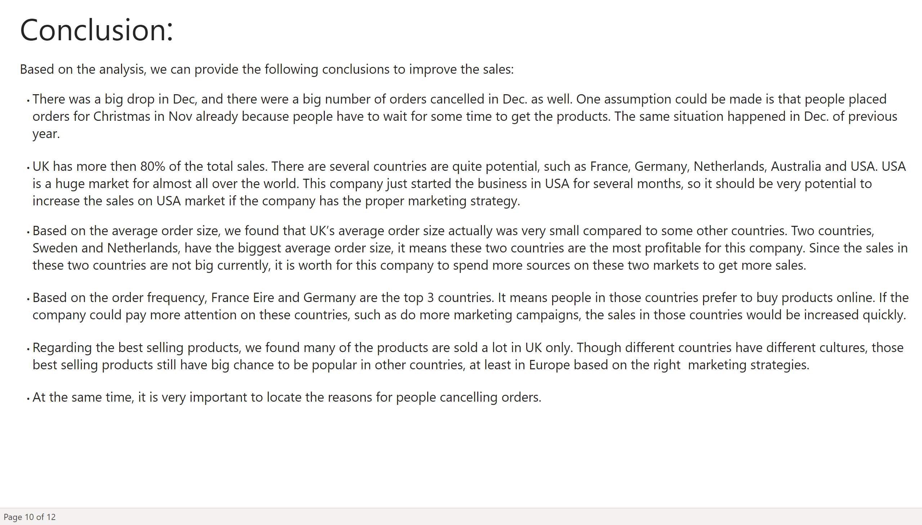
Conclusion
Notes:
textbox
No alt text provided
textbox
No alt text provided

Slide 12
Recommendations For Marketing & Sales Department
Develops special promotions in Dec. to attract more orders due to the special situation.
Develops plans of the business development in “New” market, such as USA, France, Germany, Netherlands, Australia , etc.
Develops new products combo packages by countries.
Creates more sales channels on the website, such as cross sell, upsell, down sell, etc ..
Develops plans to improve shipping efficiency and down the shipping cost.
Develops plans for sourcing more new suppliers, drop shopping suppliers locally in different country to improve the customer satisfaction level, reduce the cancel orders.
Data Source: www.Kaggle.com

Slide 13

Q&A
Challenges
Dataset:
Data Clean
Data Visualization
Program:
Use the proper package, class, or methods
Present data properly
Notes:
image
No alt text provided

Slide 14
Learning:
Barry:
Python is really powerful, such as the limitation of data handling, data processing (isnull, delete duplicate, etc..)
Python is very flexible compared with other language , such as SQL
Use professional tools to do the right thing (Python, Power BI, Excel)
Margaret:
cleaning of data first makes it easier to analyze the dataset
Learnt that you can actualize so many insights from a single dataset

Slide 15

Q&A
Notes:
image
No alt text provided

Slide 16

Thank you
Notes:
textbox
No alt text provided

